Slide 1
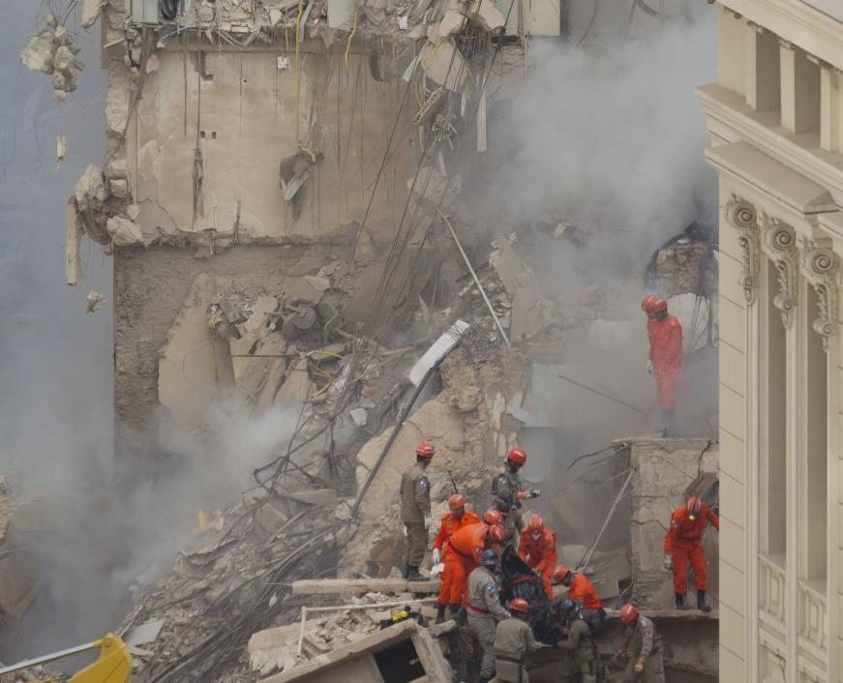


REGIONAL MASS FATALITY MANAGEMENT RESPONSE SYSTEM PLAN
September 18-20, 2012
Annual RCPGP Conference
Seattle, WA

Slide 2
Welcome
Agenda
Objectives
Scenario
Group 1: Scene Operations
Group 2: Information Management / Public Information
Group 3: Family Assistance Center (FAC)
Notes:
Scene Ops- Dave
Public Info- Greg
FAC- Alison/Erin

Slide 3
Objectives
Immersion into a mass fatality incident.
Identification of challenges and shortfalls in local response capabilities.
Discuss the potential complications associated with information management and potential solutions.
Discuss the management of expectations among families/friends, public officials, response workers and the media/public.
Examination of public information protocols and potential challenges.
Determine the need for a Family Assistance Center (FAC) and the scope of the operation.

Slide 4
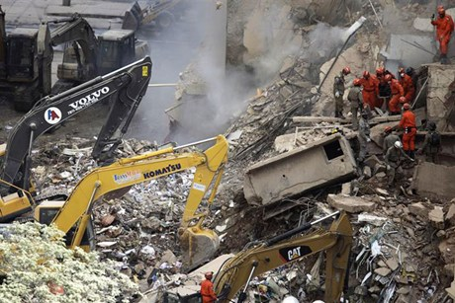
Scenario
On a weekday morning at 10:30 am a 20 story office building in the City Center collapsed. Several witnesses report seeing the building shift prior to collapse; however, none report any explosions. As there was no warning, no victims were able to escape.
While there are few permanent offices located in the building, the primary use is for conference space – currently, the space was being used for a conference on global government relations and was host to several international dignitaries participating in the event.

Slide 5
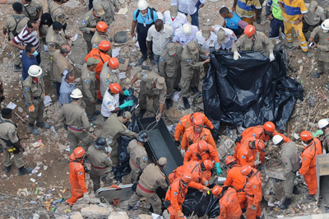
Scenario (cont.)
The local Fire Department, Police Department and Emergency Medical Services are on-scene and are assisting with scene security and attempting to locate any survivors. It is estimated that upwards of 400 people could be trapped in the building, many of which will not be rescued.

Slide 6
DISCUSSION 1

Slide 7
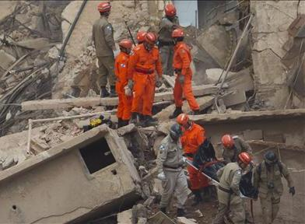
Scene Operations
Incident Characterization
Notifications
Agency role and responsibilities
Resources Needed

Slide 8
Scene Operations
How can you best support the local Medical Examiner / Coroner?
What are the breaking points? What are the issues that if you fail, the whole operation is a failure?

Slide 9
DISCUSSION 2

Slide 10
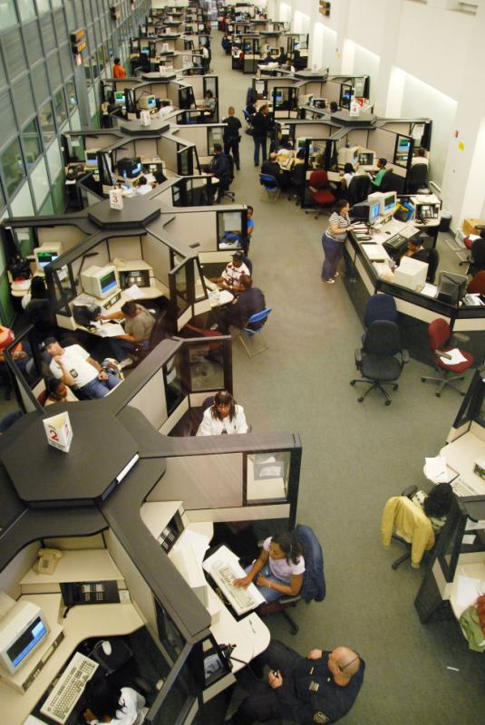
Information Management
Manifest (Open / Closed)
Reporting Mechanism for missing persons

Slide 11
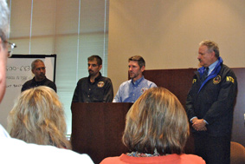
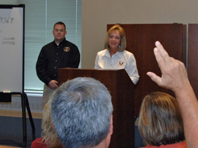
Public Information
Public Messaging
Family Briefings
Media Inquiries
Managing Expectations

Slide 12
DISCUSSION 3

Slide 13
Family Assistance Center
FAC Activation Decisions and Timelines
FAC Set Up
Location
Responsible Agencies
What are the breaking points? What are the issues that if you fail, the whole operation is a failure?

Slide 14
Questions?
Allison Woody
awoody@mchd-tx.org
Dave Boyer
dboyer@mchd-tx.org
Greg Smith
gsmith@mchd-tx.org
Erin McLachlan
emclachlan@regionalcatplanning.org
Emily Carroll
emcarroll@ocme.nyc.gov

